Slide 1

EAA 2025: Are You Ready?
What You Need to Know and Do Before the June 28 EAA Deadline

Slide 2
Housekeeping & Rules of Engagement
Welcome!​
Thank you for joining our webinar!
Before we begin, here are some housekeeping notes:
  Attendee lines are muted and cameras are turned off.​
  Please feel free to use the "Chat" feature and the "Q&A" to submit questions.​
  Recording Notice: This webinar is being recorded.
  The webinar content will be available on the Struto uniVERSE after this session.
  Your feedback is valuable to us! Please complete the webinar survey when you receive it.​
  Marketing Opt-In: By joining this webinar, you are opted in for our marketing updates. You can unsubscribe at any time.
We hope you enjoy the webinar and find it valuable!
Notes:
Nsovo

Slide 3
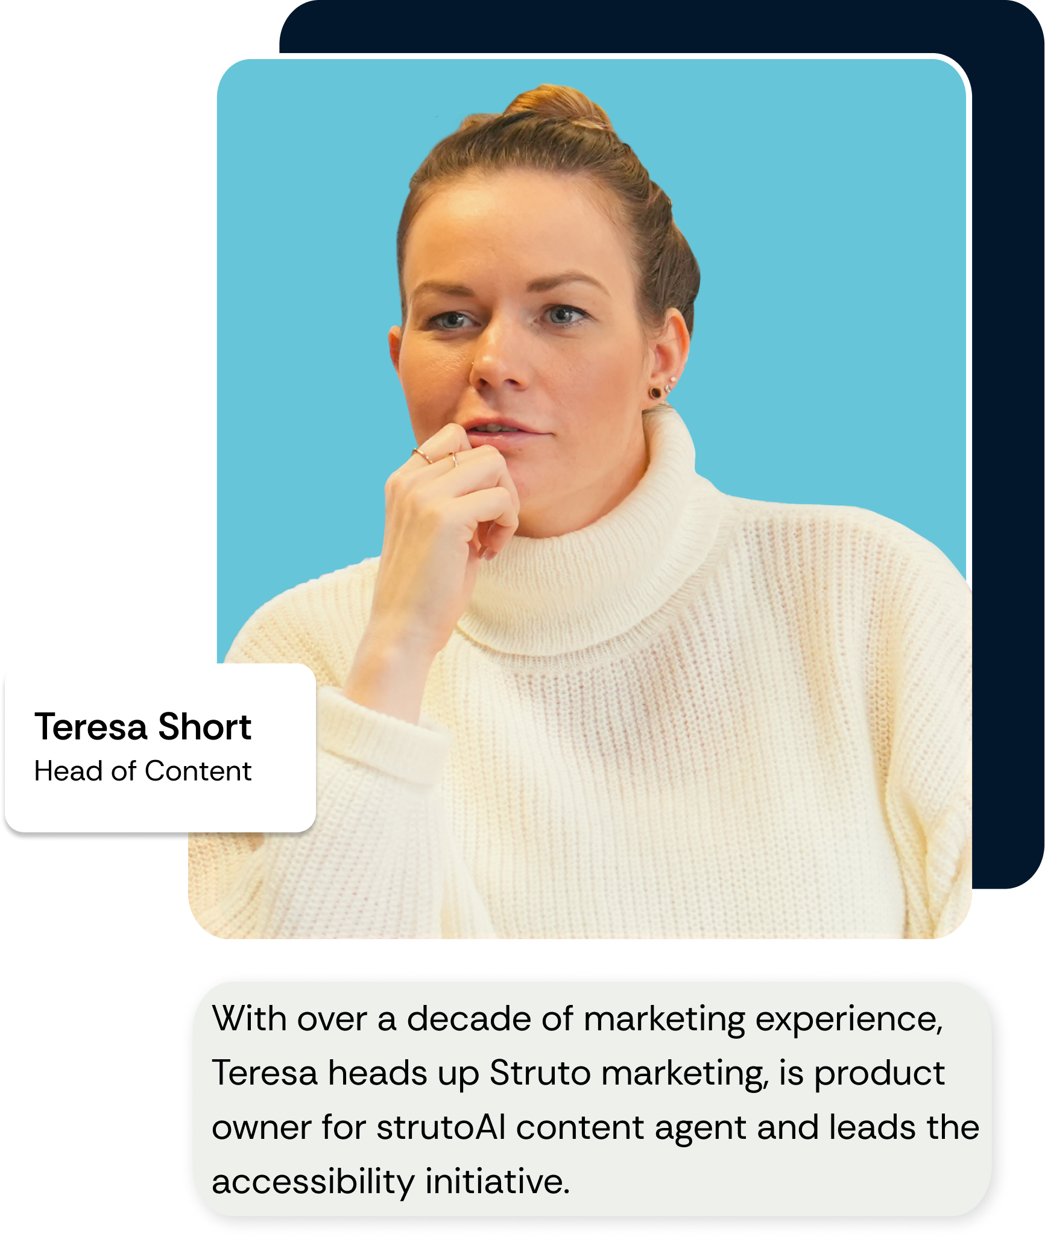
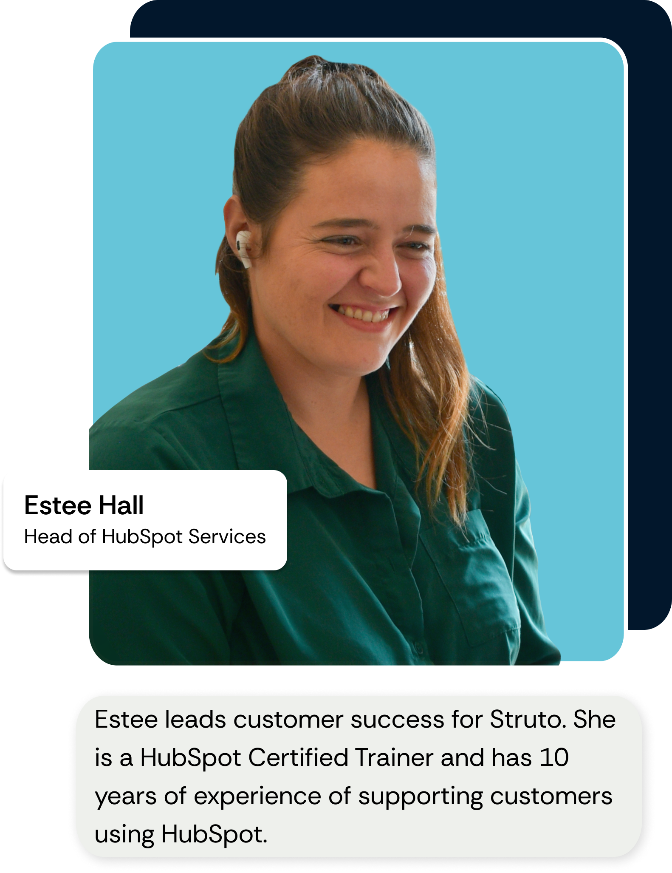

Your Hosts
Notes:
Nsovo to intro hosts. Ryan and Sean to introduce themselves.

Slide 4

Agenda
What the EAA is and who it applies to
What happens if you miss the June 28 deadline
The three core risks: legal, brand, and customer
UX and technical gaps we keep seeing
Why accessibility is a growth lever, not just a regulation
And finally, practical steps you can take, right now, to get on track
Notes:
Nsovo

Slide 5

Understanding the EAA
EU law mandating accessible digital products & services
Applies to businesses with:
  10+ employees
  €2M+ revenue
  EU operations (even if HQ is elsewhere)

Slide 6

The Clock is Ticking
Deadline: June 28, 2025
Penalties: fines, tender disqualification, reputational damage
Brand trust is on the line
Inaccessibility = missed connection & conversions

Slide 7



The 3 Layers of Risk
Legal
Brand
Customer
Fines
Lawsuits
Disqualification
Reputation damage
Churn
Exclusion
Drop-offs

Slide 8

Accessibility in Action
Missing alt text
Inaccessible forms
Inconsistent headers
Low colour contrast
No keyboard nav
Videos without captions

Slide 9



The 3 Biggest Gaps
No Ownership
2. Outdated Systems
3. Superficial Fixes

Slide 10

It’s Not Just Compliance
Accessibility = Performance
Reach new users
Improve SEO
Boost brand equity
Outperform competitors

Slide 11

Your Action Plan
Appoint an accessibility owner
Get a baseline audit
Prioritise high-impact fixes
Integrate accessibility into UX/content/dev
Plan for ongoing review

Slide 12

Struto Value Add
Complimentary audit
Scrape website page
Offer bespoke recommendations
Compliance roadmap with priority actions
Developer support from award-winning team

Slide 13

Your Questions, Answered
Drop your questions in the chat box – we’re ready.

Slide 14


